Slide 1
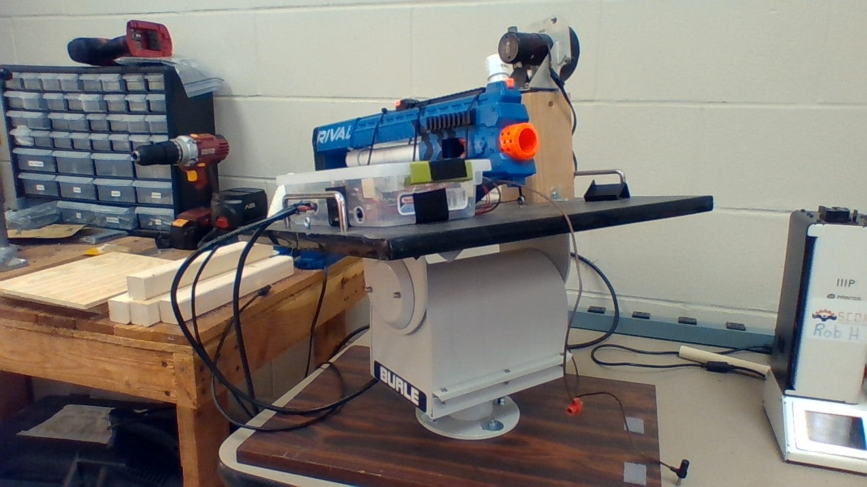
T.H.A.D: the helpful automated defender
By: Joshua Jablonowski and Joseph Hinely
Notes:
Give background info on old project

Slide 2
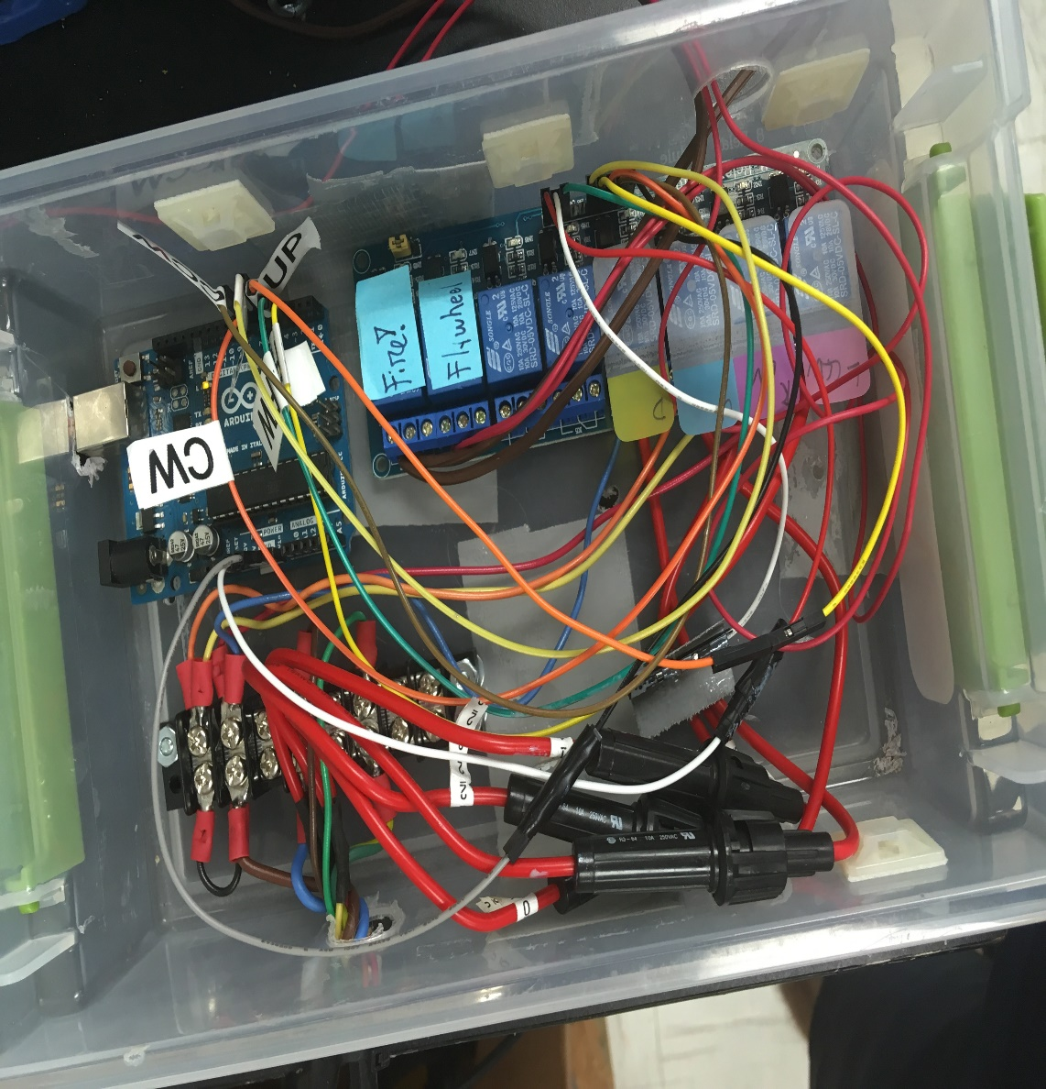
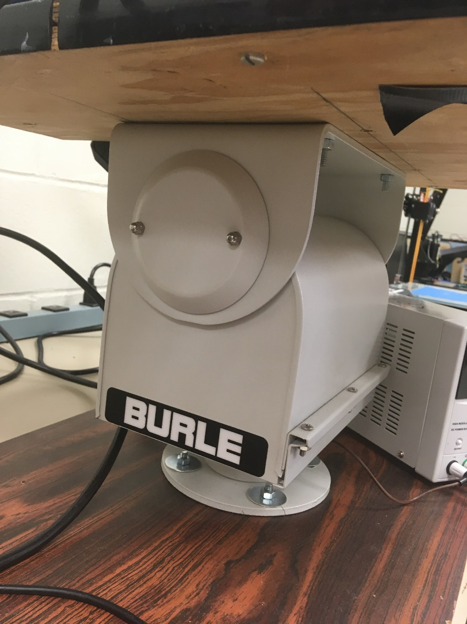
ORIGINAL Hardware: turret, GUN, and Relays
Notes:
Talk on the black box turret- multiple voltage levels needed

Slide 3
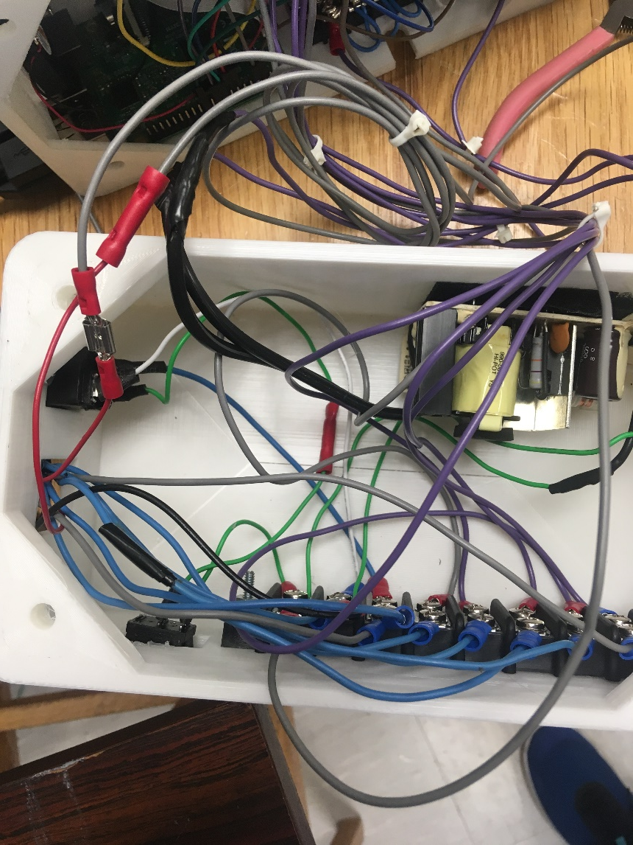
New Hardware: terminal connections
Terminal used for power and turret connections
Case used to house wiring, and all electronics in a convenient location
Challenges in determining the turret operation method
Notes:
Almost left it open, but is dangerous to transport in that state

Slide 4
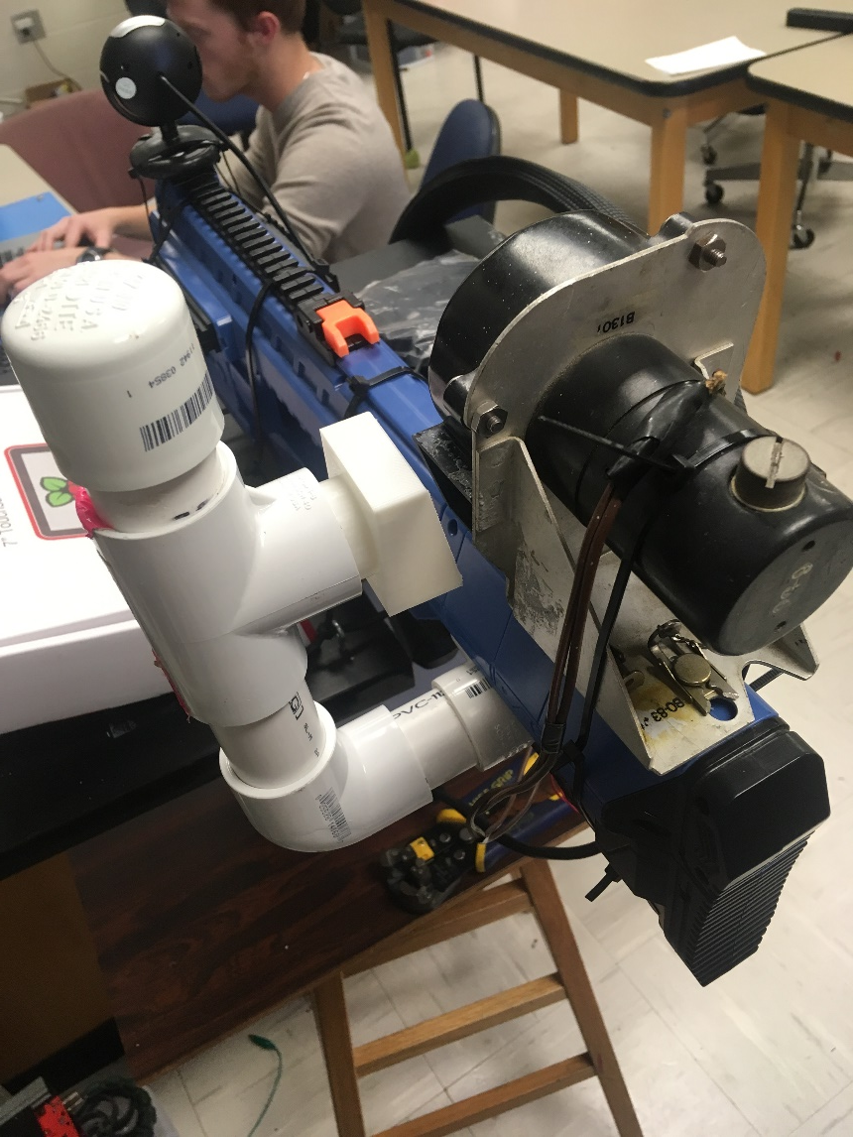
NEW HARDWARE: BLOWER POSITIONING , CAMERA AND 24V Source
The blower uses a 24VDC laptop power supply to run, which is controlled via relay
A new configuration was made to allow for easier loading
A new blower joint was made to better fit

Slide 5
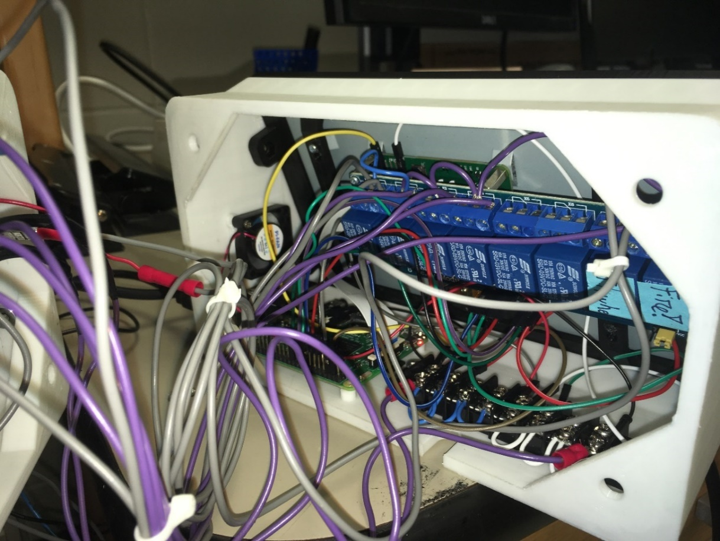
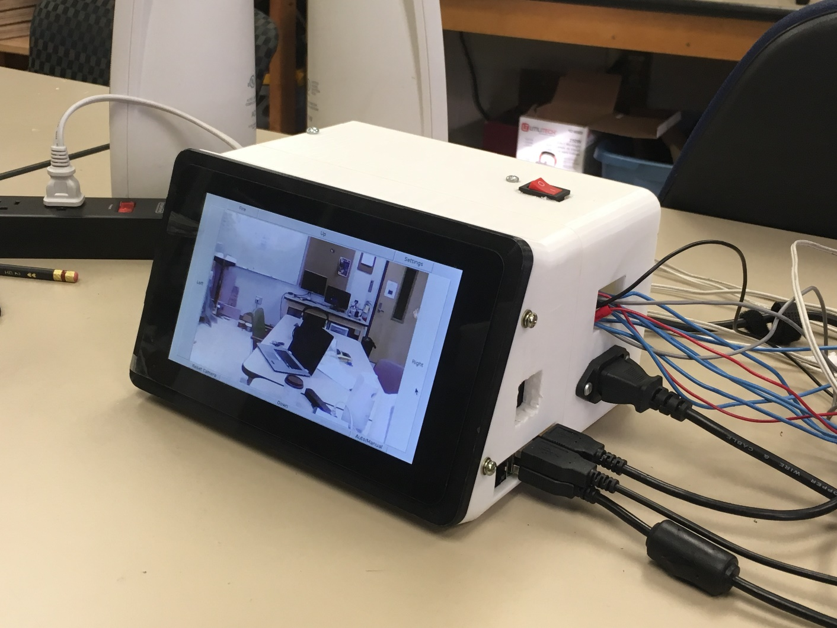
NEW HARDWARE: RASPBERRY PI AND SCREEN

Slide 6
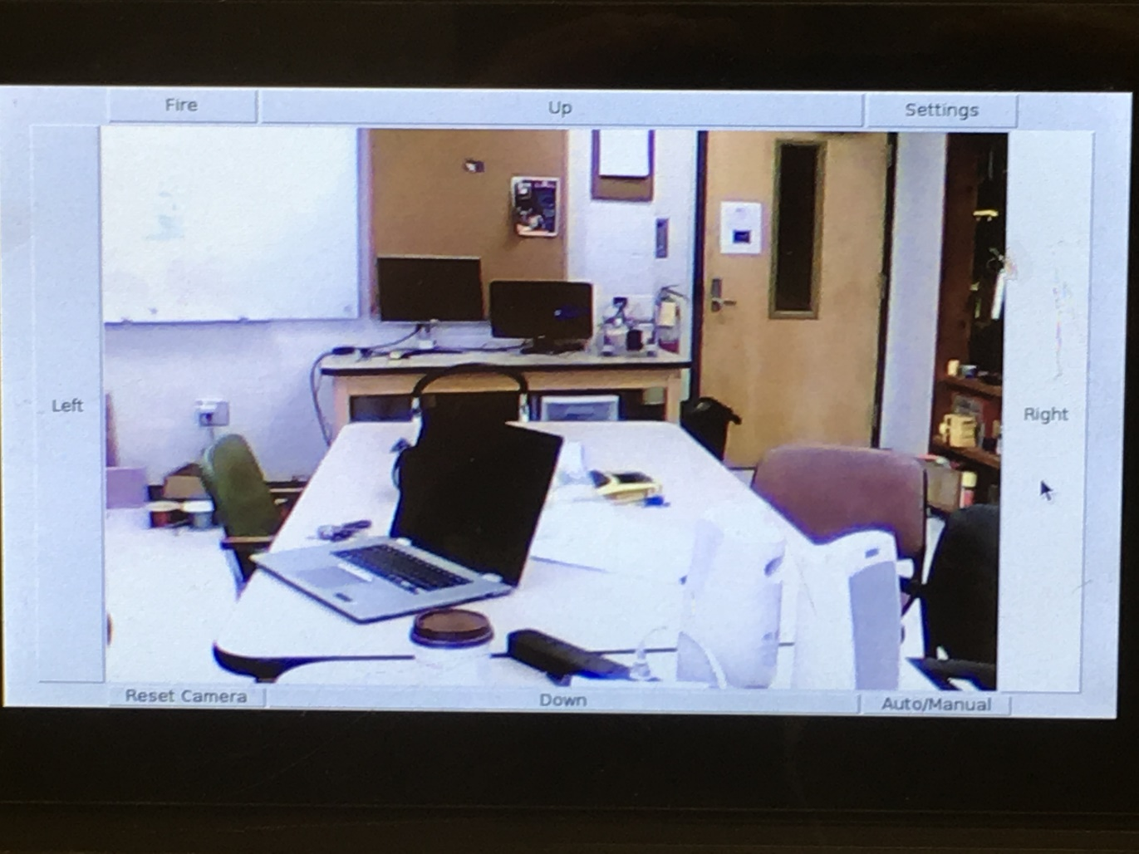


Software: User interface
Allows for ease of use and switching between automatic and manual modes
Entirely coded in Python, utilizing the OpenCV and Tkinter libraries

Slide 7
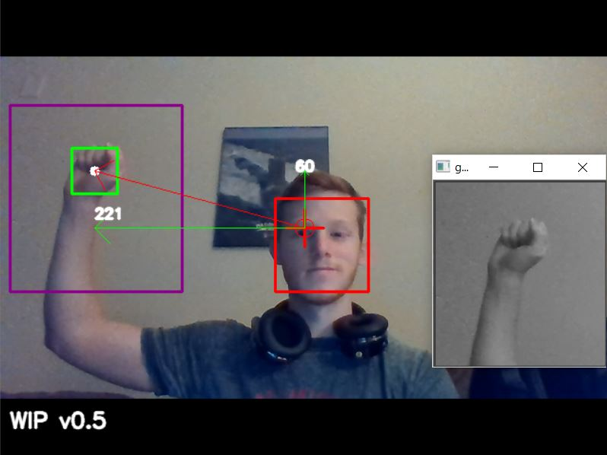
Software: target DETERMINATION
Searches for a hand in a certain region of the image based on detected faces
If exactly one is found, the gun is fired
Notes:
From white paper

Slide 8
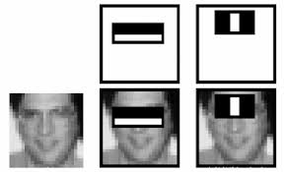
Software: HOW IT WORKS
Utilizes Haar-Cascade classifiers for facial recognition
Code Snippet:
##### Detect Faces
face_cascade = cv2.CascadeClassifier(../haarcascade_frontalface_default.xml')
gray = cv2.cvtColor(frame,cv2.COLOR_BGR2GRAY) #Convert to grayscale
faces = face_cascade.detectMultiScale(gray, 1.1, 5) #Detect faces
Notes:
Talk on RPi Challenges and hardware improvements

Slide 9
A Brief demonstration

Slide 10
Behind the scenes demonstration

Slide 11
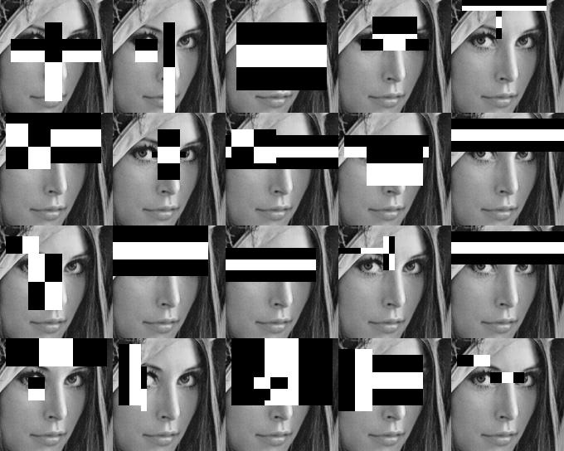
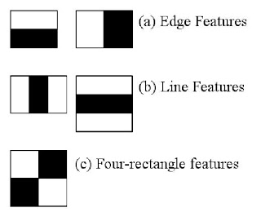
Software: WHAT IS A HAAR CASCADE?
Initially, a classifier is trained using a well documented algorithm.
Simple features are extracted from each image- shown to the right
If the detector finds a key feature in the image, it will continue to another one, weighted by most prominent
If all of the relevant features are detected- the region is considered to be the object the classifier was trained for.

Slide 12
FUTURE IMPROVEMENTS
Running computer vision calculations “in the cloud”
Friendlier UI
Open Hand Haar-Cascade Training
Automatic Ammo Loader
Dead Reckoning

Slide 13
Questions?
All information and further documentation is available on github.com/SPARC-Auburn

